Slide 1
Welcome to the Allegheny Mountain
Section Meeting

Slide 2
MAA’s Mission
The mission of the Mathematical Association of America is to advance the understanding of mathematics and its impact on our world.

Slide 3
MAA’s Vision
We envision a society that values the power and beauty of mathematics and fully realizes its potential to promote human flourishing.

Slide 4
New MAA/AWM/NAM Section Lecturer Series
MAA is pleased to announce two new programs developed in partnership with the Association for Women in Mathematics (AWM) and the National Association of Mathematicians (NAM).
The new program will complement the George Polya lectureship bringing excellent expositors and a diverse group of speakers representing early-career mathematicians to our audiences.
Learn more!

Slide 5
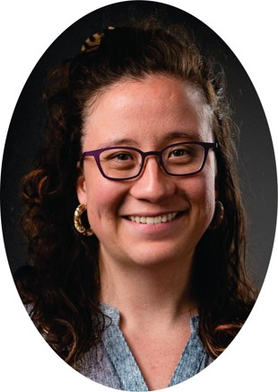
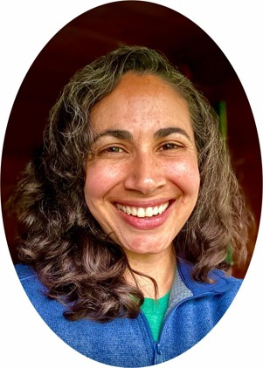
Meet Our New AWM Section Speakers
For speaker details and abstracts, visit our website
Catherine Hsu
Swarthmore College
Anastasia Chavez
University of California, Davis

Slide 6
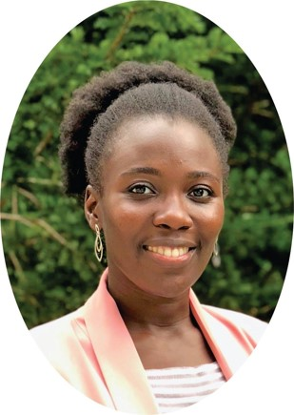
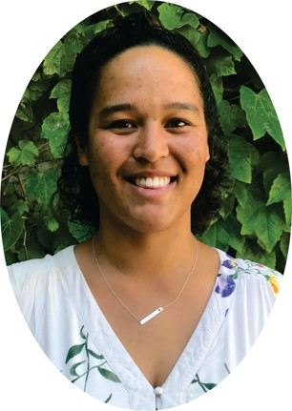
Meet Our New AWM Section Speakers
For speaker details and abstracts, visit our website
Karamatou Yacoubou Djima
Amherst College
Marissa Loving
Georgia Institute of Technology

Slide 7
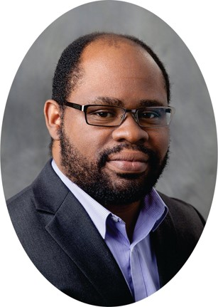
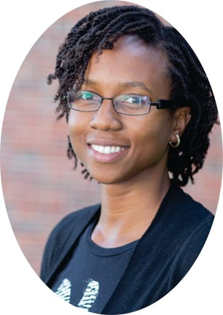
Meet Our New NAM Section Speakers
For speaker details and abstracts, visit our website
Jose Perea
Michigan State University
Haydee Lindo
Harvey Mudd College

Slide 8
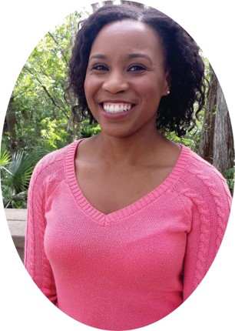
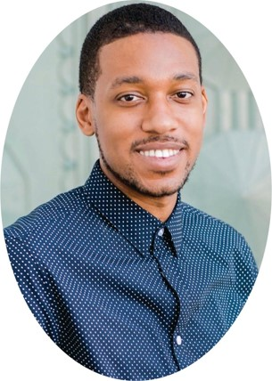
Meet Our New NAM Section Speakers
For speaker details and abstracts, visit our website
Talea Mayo
Emory University
Lorin Crawford
Microsoft Research New England

Slide 9
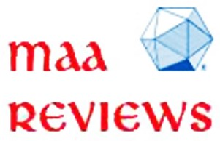
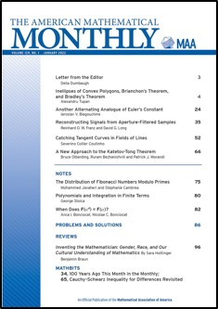
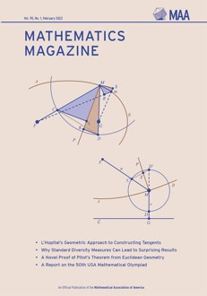
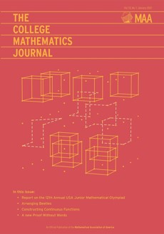
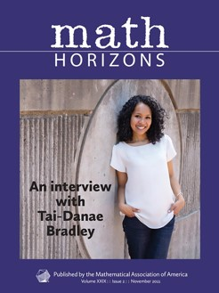
Publications
MAA Journals and Magazines can be accessed by logging in to your member profile on maa.org.
There are eight featured book reviews published two or three times a month. They provide information on what’s new, what’s good, and what’s recommended for libraries.
The American Mathematical Monthly
Mathematics Magazine
The College Mathematics Journal
Math Horizons

Slide 10
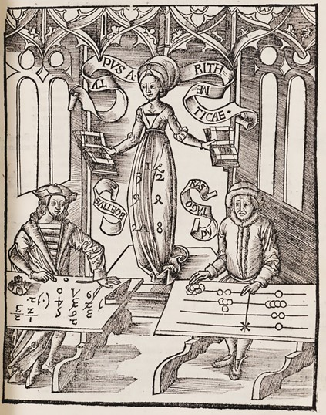
Convergence
What treasure from the past will you find today on MAA Convergence?
Questions about MAA Convergence? Contact Janet Barnett (janet.barnett@csupueblo.edu) or Amy Ackerberg (aackerbe@verizon.net).
A Mathematical Treasure: Engraving of Arithmetica from Gregor Reisch, Margarita philosophica. Courtesy of Columbia University.
maa.org/convergence

Slide 11
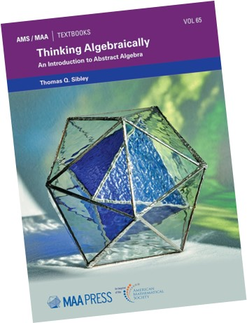
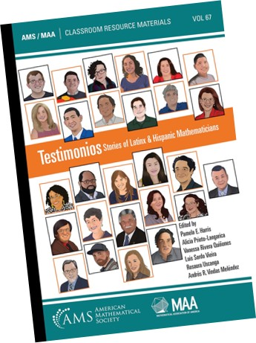
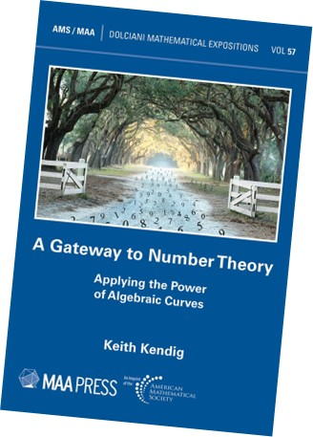
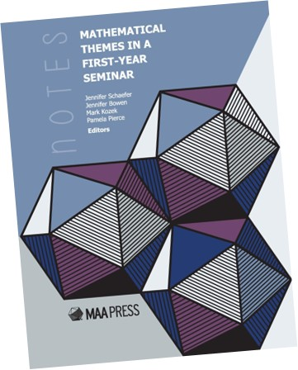
MAA Press
MAA Members save 25% on MAA Press titles from the AMS Bookstore
MAA Members can get Notes volumes and selected other volumes for free in their Member Library.

Slide 12
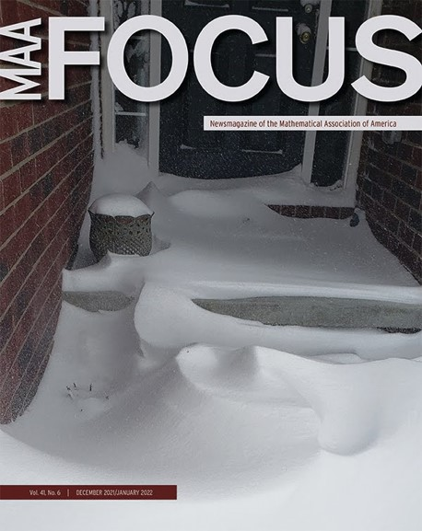
MAA FOCUS
MAA FOCUS is the news magazine of the MAA, and is provided in print to all non-student members.
If you have news, a pedagogical innovation, or anything else you wish to share with the entire membership, MAA FOCUS may be the appropriate venue.
Questions about a particular idea or submission? Contact Jacqueline Jensen-Vallin at maafocus@maa.org.
Allison Henrich is the editor-elect for MAA FOCUS. Her term begins with the August/September 2022 issue.

Slide 13
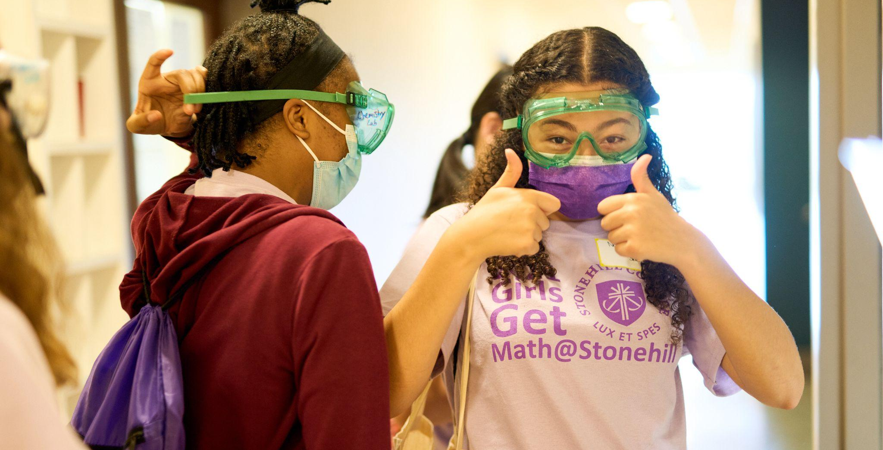
It's never too early to start thinking about funding!
The MAA offers several funding opportunities through its outreach programs each year, to ensure students are supported in their journey to learn about the mathematical sciences. Check out our upcoming funding applications!
Dolciani Mathematics Enrichment Grants, Tensor Women & Mathematics Grants, Tensor SUMMA Grants, and the National Research Experience for Undergraduates Program will once again be accepting applications next fall!
GET FUNDED!
Learn more at maa.org/programs

Slide 14
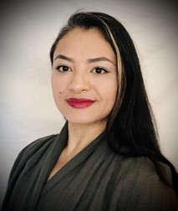
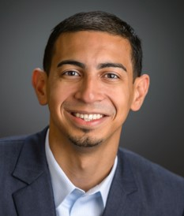
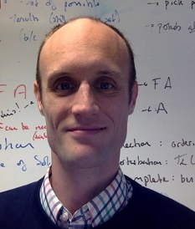
The MAA Distinguished Lecture Series Returns!
The prestigious MAA Distinguished Lecture Series is moving online!
Join us for expository mathematics presentations on current topics in the field
Dr. Pamela E. Harris, Williams College
“Multiplex Juggling Sequences and Kostant's Partition Function”
January 27, 2022 | 7:00pm - 8:00pm EST
WATCH
NOW
Dr. Alexander Diaz-Lopez, Villanova University
“Encryption Methods: Past, Present, and Future”
February 23, 2022 | 7:00pm - 8:00pm EST
WATCH
NOW
Dr. Nathan Carter, Bentley University
“Mathematics in Data Science”
March 23, 2022 | 7:00pm - 8:00pm EST

Slide 15
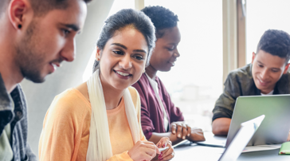
Meet OPEN Math - MAA’s Newest Program!
Expands access to high-quality faculty professional development by eliminating the costs of travel
OPEN Math will support over 40 intensive online PD workshops for undergraduate math instructors.
Each workshop will cultivate a community of support for participants, and among the workshop leaders.
Be on the lookout for more information and an opportunity to apply for the Summer 2022 OPEN Math online professional development workshops!
New OPEN Math Workshop Series
OPEN Math is a collaborative project between the Mathematical Association of America (MAA) and the University of Colorado, Boulder (CU-B). Support for OPEN Math is provided by the National Science Foundation: MAA Award DUE-2111260 and CU-B Award DUE-2111273.
maa.org/open-math

Slide 16
FEBRUARY-APRIL
MAA Virtual Programming is back with a whole new lineup of programs for Spring 2022.
View the schedule and register at maa.org/virtual-programming.

Slide 17
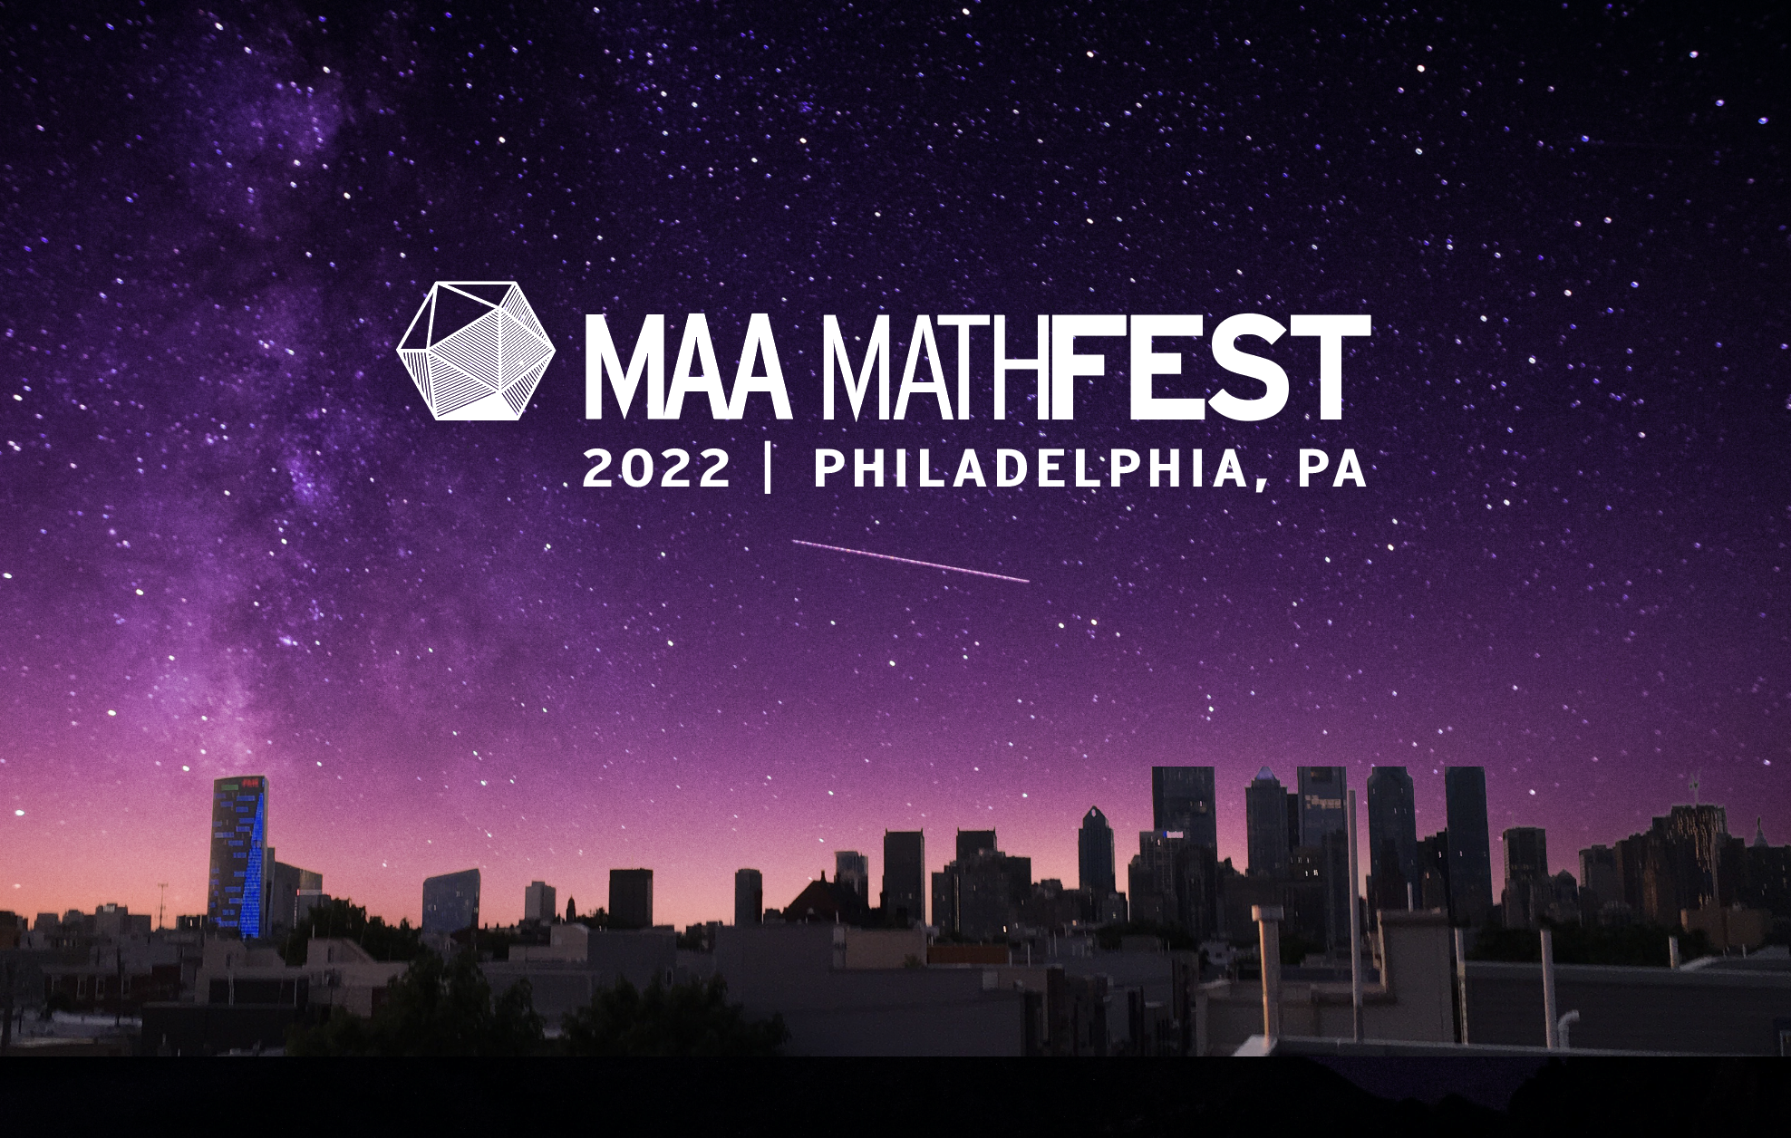
August 3-6
Philadelphia Marriott Downtown

Slide 18
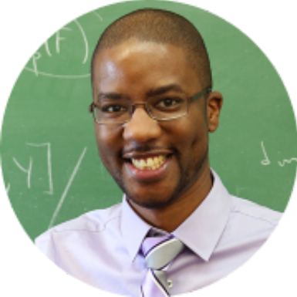
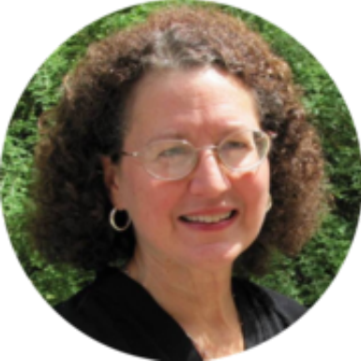
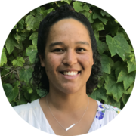
Chris Jett
University of West Georgia
Suzanne Lenhart
University of Tennessee
Marissa Kawehi Loving
Georgia Tech
Preview these invited speakers and more at maa.org/mathfest

Slide 19
New Membership Benefits
Take Advantage of your new MAA member benefits:
MAA Connect
Math Values, MAA’s blog
Affinity Program discounts
A discounted subscription to Wondrium
MAA Video Library
PRIMUS
CHANCE
American Journal of Mathematical and Management Sciences
Journal of Mathematics and the Arts
Cryptologia
Mathematical Thinking and Learning
International Journal of Mathematical Education in Science and Technology

Slide 20
Departmental Memberships
Membership Benefits Include:
Membership for up to 450 math students
Membership for one faculty/staff member
VITAL faculty memberships for only $79 each (for Visitors, Instructors, TA’s, Adjuncts, Lecturers employed at your Institution)
maa.org/join

Slide 21
Membership Categories
Find the MAA membership that fits you best:
TRANSITIONAL MEMBERSHIP
Graduating MAA student members can receive a full MAA membership for only $59 per year for their first two years post-graduation.
VITAL
Visitors, Instructors, Teaching Assistants, Adjuncts, and Lecturers at Departmental Member institutions can receive a full MAA membership for only $79 per year. Plus VITAL members receive an exclusive discount to MAA MathFest!
http://maa.org/membership-categories

Slide 22
Membership Categories
Find the MAA membership that fits you best:
LIFE MEMBERSHIP
Simplify your MAA membership with a single payment that provides membership for life. Available now at a special introductory rate.
RETIRED
Renew your MAA membership for only $100 a year if you have 25 or more years of MAA membership and are no longer actively employed.
http://maa.org/membership-categories

Slide 23
Communities
Join a SIGMAA
There are 17 Special Interests Groups of the MAA (SIGMAA) that embody a variety of interests which advance the organization’s mission and offer networking opportunities and access to resources in your field of interest.
Connect with practitioners and scholars
Share ideas and perspectives
Bridge the gap between collegiate mathematics education and high school mathematics
For more information, including a full list of groups, visit maa.org/member-communities/sigmaas

Slide 24
MAA Connect
Stay involved with our Section through our dedicated community on MAA Connect.
Keep the conversations going from your experiences at our annual meeting
Follow Section news as we post important announcements in our community
maa.org/connect

Slide 25
MAA Connect
More Ways to Engage on MAA Connect
Private communities for each SIGMAA for discussions relevant to your areas of interest and expertise
An all MAA Member Community where you can ask questions and share your own experiences with your peers
Connect with any member - anywhere, at any time!
And so much more!
Questions? Contact communities@maa.org
maa.org/connect

Slide 26
In Our MAA Section
Section initiatives
Allegheny Mountain Section NExT
Allegheny Mountain Colloquium Series-virtual talks at the undergraduate level

Slide 27
In Our MAA Section
Fall Section NExT workshop is in October and the Spring Section Meeting and Spring Section NExT workshop will be at Edinboro University in April

Slide 28
In Our MAA Section
The deadline for our Section teaching/service/mentoring award nominations is in January.
We are always looking for nominations for awards and for officer positions. We also seek people willing to serve on the committees for awards and the nominating committee.

Slide 29
Registering for the AMC also opens up the opportunity to engage future students for your university!
Learn more about hosting the American Mathematics Competition (AMC) during the 2022-23 school year! With the new changes to the AMC, hosting the competition is even easier than before. To host the AMC, you need to follow 3 simple steps:
Register for the AMC
Practice past AMC problems with students
Administer the competition

Slide 30
Recently Expanded: The AMC Certificate and Prize Program
After each competition, the top five highest scoring female students in each MAA Section will receive a specialized certificate and the top five highest scoring female students in the country will receive $1000 each. We encourage you to use this opportunity to connect with the young girls in your area - invite them to your section meeting to witness MAA in action, as well as give some of the brightest mathematical minds a peek into your university and mathematics department.

Slide 31
Support the MAA
Thank you to our donors!
With support from donors and sponsors, MAA:
Expanded the AMC Young Women in Mathematics Prize and Certificate Program to all levels of our AMC Competition
Accepted more than 100 Project NExT Fellows, bringing the total Fellows count to over 2,000
Served more than 500,000 students, professors, and mathematicians
Raised enough money to add 4 additional Project NExTers to the 2022 cohort!
Support MAA today! www.mightycause.com/donate/Math

Slide 32
Follow MAA
@maanow
@maanews
Keep up with MAA on social media.
Tag us so we can share news and updates from your MAA Section!

Slide 33
Communications
Make sure you aren’t missing MAA communications! We ask that you add our email address (maaservice@maa.org) to your contact list or mark us as a safe sender.
With this update, we can share the latest funding opportunities, professional development, and conference updates in 2022 to best support your mathematical journey.
Check out this helpful article to learn how to add the MAA as a safe sender.

Slide 34
Thank you for being a part of the MAA Community!

